Slide 1
More on 1-D Arrays
Overview
Array as a return type to methods
Array of Objects

Slide 2
Array as return type to methods
We saw in the last lecture, that arrays can be passed as parameters to methods.
In addition, methods can return array as their result a reference to an array object.
import java.io.*;
class ArrayAndMethods {
static BufferedReader stdin = new BufferedReader( new InputStreamReader(System.in));
public static void main(String[] args) throws IOException {
int size;
System.out.print("Enter array size: ");
size = Integer.parseInt(stdin.readLine());
double[] firstArray = createArray(size);
double[] secondArray = createArray(size);
System.out.println("The dot product = "+dotProduct(firstArray, secondArray));
}

Slide 3
Array as return type to methods
  static double[] createArray(int size) throws IOException {
  double[] array = new double[size];
  System.out.println("Enter "+size+" elements for this array: ");
  for (int i=0; i<size; i++)
  array[i] = Double.parseDouble( stdin.readLine());
  return array;
  }
  static double dotProduct(double[] first, double[] second) {
  double sum = 0;
  for (int i=0; i<first.length; i++)
  sum += first[i]*second[i];
  return sum;
  }
}

Slide 4
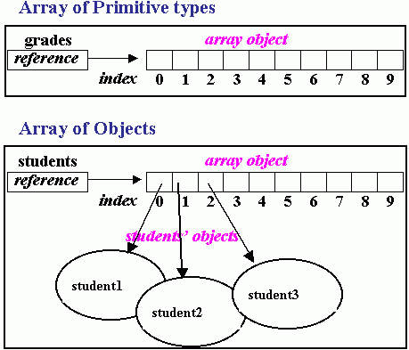
Array of Objects
In the examples we have seen so far, we have been creating arrays whose elements are primitive types.
We can equally create an array whose elements are objects.
Assuming we have a class named Student, then we can create an array, students, to hold 10 Student objects as follows:
Student[] students = new Student[10];

Slide 5
Array of Objects (cont’d)
As you can see from the figure, there is a fundamental difference between an array of primitive type and an array of object.
Here, the array only holds references to the actual objects.
The statement:
Student[] students = new Student[10];
only creates the references. To actually create the objects, we have to use the new operator, usually in a loop as follows:
for (int i = 0; i < students.length ; i++)
students[i] = new Student(id, grade);
The following is the complete Student example.
class Student {
int iDNumber;
double grade;
public Student(int iDNumber, double grade) {
this.iDNumber = iDNumber;
this.grade = grade;
}
public void print() {
System.out.println(iDNumber+"\t"+grade);
}
}

Slide 6
Array of Objects (cont’d)
import java.io.*;
public class ArrayOfObjects {
static BufferedReader stdin = new BufferedReader( new InputStreamReader(System.in));
public static void main(String[] args) throws IOException {
int size;
System.out.print("Enter number of students: ");
size = Integer.parseInt(stdin.readLine());
Student[] students = createArray(size);
double average = average(students);
System.out.println("The average is "+average);
System.out.println("Students below average are");
for (int i=0; i<students.length; i++)
if (students[i].grade < average)
students[i].print();
}

Slide 7
Array of Objects (cont’d)
static Student[] createArray(int size) throws IOException {
Student[] array = new Student[size];
int id;
double grade;
System.out.println("Enter "+size+" students");
for (int i=0; i<size; i++) {
System.out.print("ID Number : ");
id = Integer.parseInt(stdin.readLine());
System.out.print("Grade : ");
grade = Double.parseDouble( stdin.readLine());
array[i] = new Student(id, grade);
}
return array;
}
static double average(Student[] studentList) {
double sum = 0;
for (int i=0; i<studentList.length; i++)
sum += studentList[i].grade;
return sum/studentList.length;
}
}

